Slide 1

EEC2022 Professional Readiness for Innovation, Employability and Entrepreneurship
Web Phishing Detection using Machine Learning Algorithms
Team ID: PNT2022TMID52926

Slide 2
PROBLEM DESCRIPTION

Slide 3



What is a phishing attack?
“Phishing” refers to an attempt to steal sensitive information, typically in the form of usernames, passwords, credit card numbers, bank account information or other important data in order to utilize or sell the stolen information.
By masquerading as a reputable source with an enticing request, an attacker lures in the victim in order to trick them, similarly to how a fisherman uses bait to catch a fish.

Slide 4
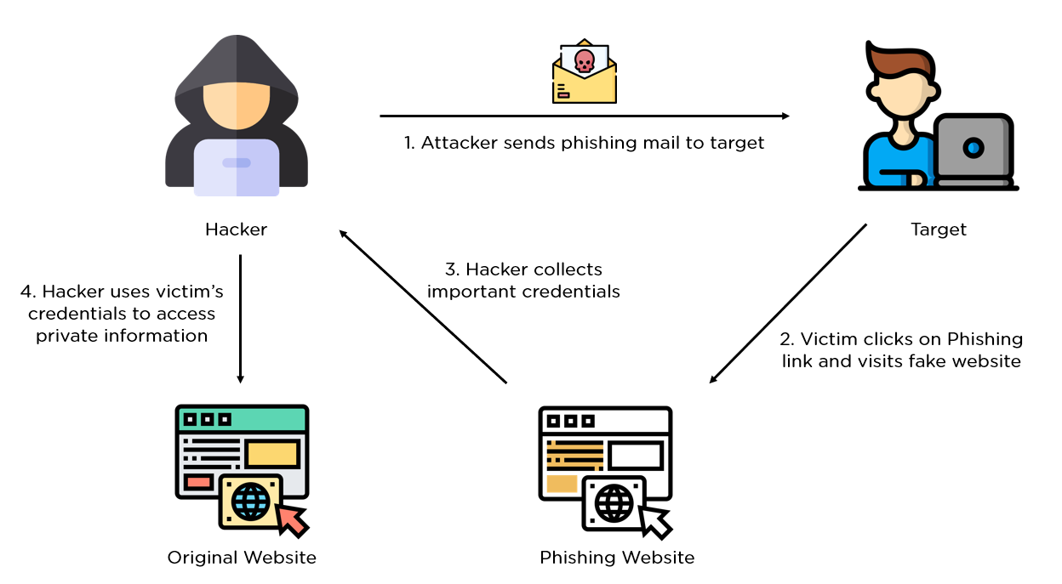

Slide 5
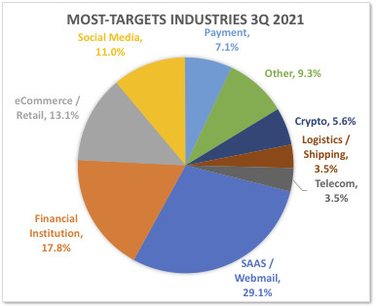
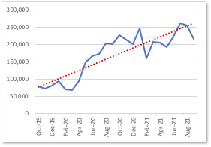
Phishing activity Trends:
The APWG report says: “Phishing Smashes All Previous Records in Q3, 2021; Phishing Attacks Double Since Early 2020”
“Our aim is to find the optimal model which will help us detect harmful website using the features given”

Slide 6
PROPOSED SOLUTION

Slide 7
Solution proposed and description:
Type of Problem: Binary Classification
Dataset: Phishing Dataset.
Number of Features: 30
Number of Datapoints: Train - 8955, Test - 2100
Proposed Models:
Logistic Regression
Support Vector Machines
K- Nearest Neighbours
Decision Trees
RNN- LSTM
Understand and Visualize Data
Correlation Matrix
Feature Engineering
+1
Build and Predict
Hyperparameter Tuning
-1

